Slide 1
Plas Dol y Moch
Earlsdon Primary School
Tuesday 24th September – Saturday 28th September 2024

Slide 2
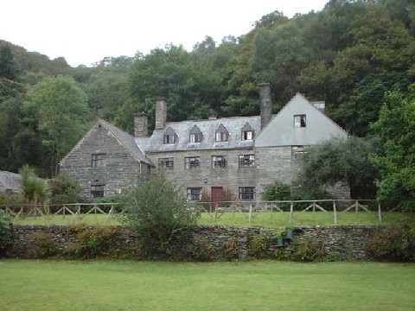

Slide 3
Plas Dol y Moch
Situated in heart of Snowdonia National Park
Close to Blaenau Ffestiniog (Port Madog-Snowdonia)
17th Century building owned by Coventry LEA since 1966
Prepares pupils of all ages and abilities for new challenges and helps to promote personal confidence and citizenship skills
Top quality education courses
Excellent facilities and location
Highly skilled and knowledgeable teachers
Life enhancing memorable experience!

Slide 4
Plas Dol y Moch
More information about the centre can be found at
www.plasdolymoch.co.uk

Slide 5
Activities
Activities http://www.plasdolymoch.co.uk/courses_and_activities.htm
Our plan is for the children to go underground, up a mountain, to the coast, on water and to undertake a Mountain Bike course.
The children will also take part in a variety of evening activities too.

Slide 6
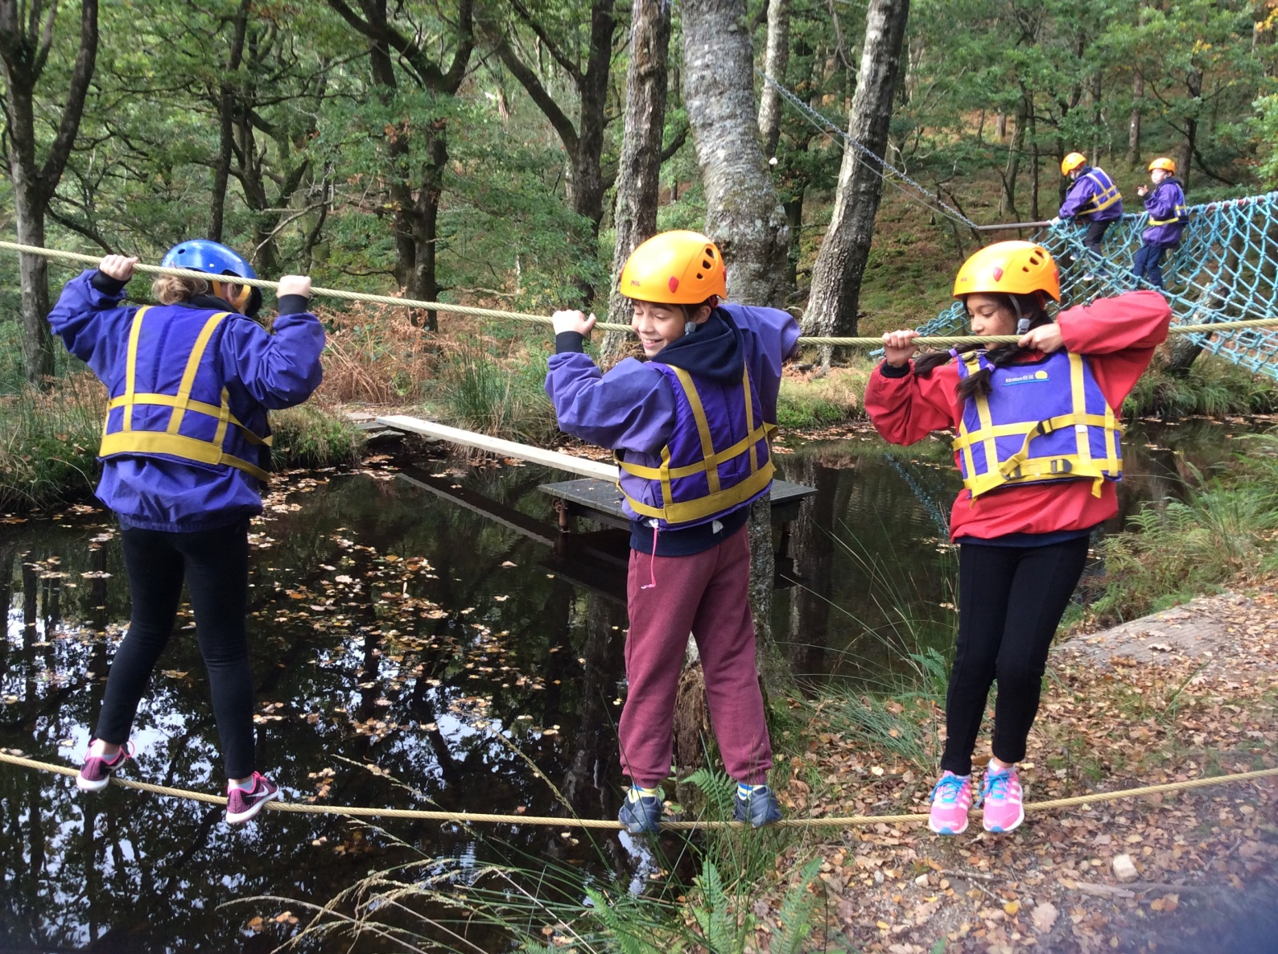
Confidence building activities

Slide 7
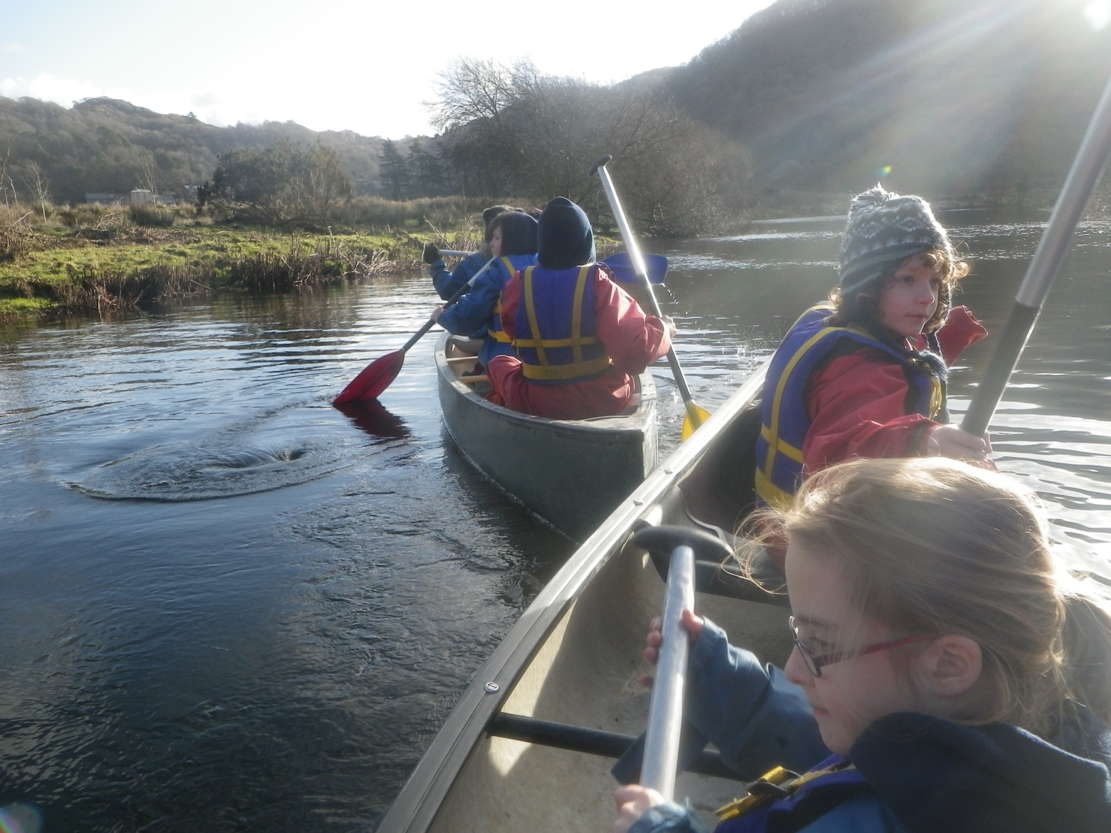
Water based activities - Canoe

Slide 8
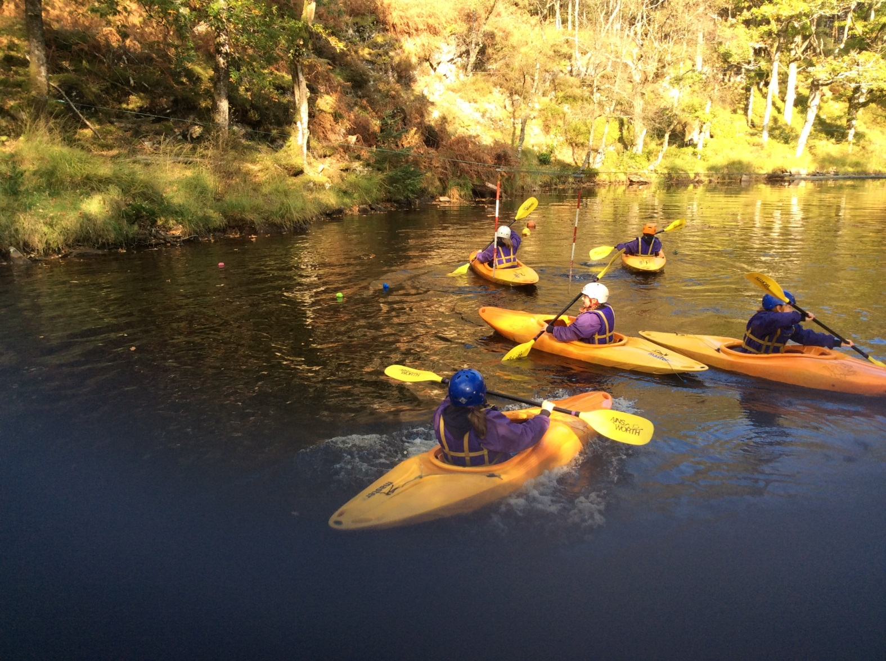
Water based activities - Kayak

Slide 9
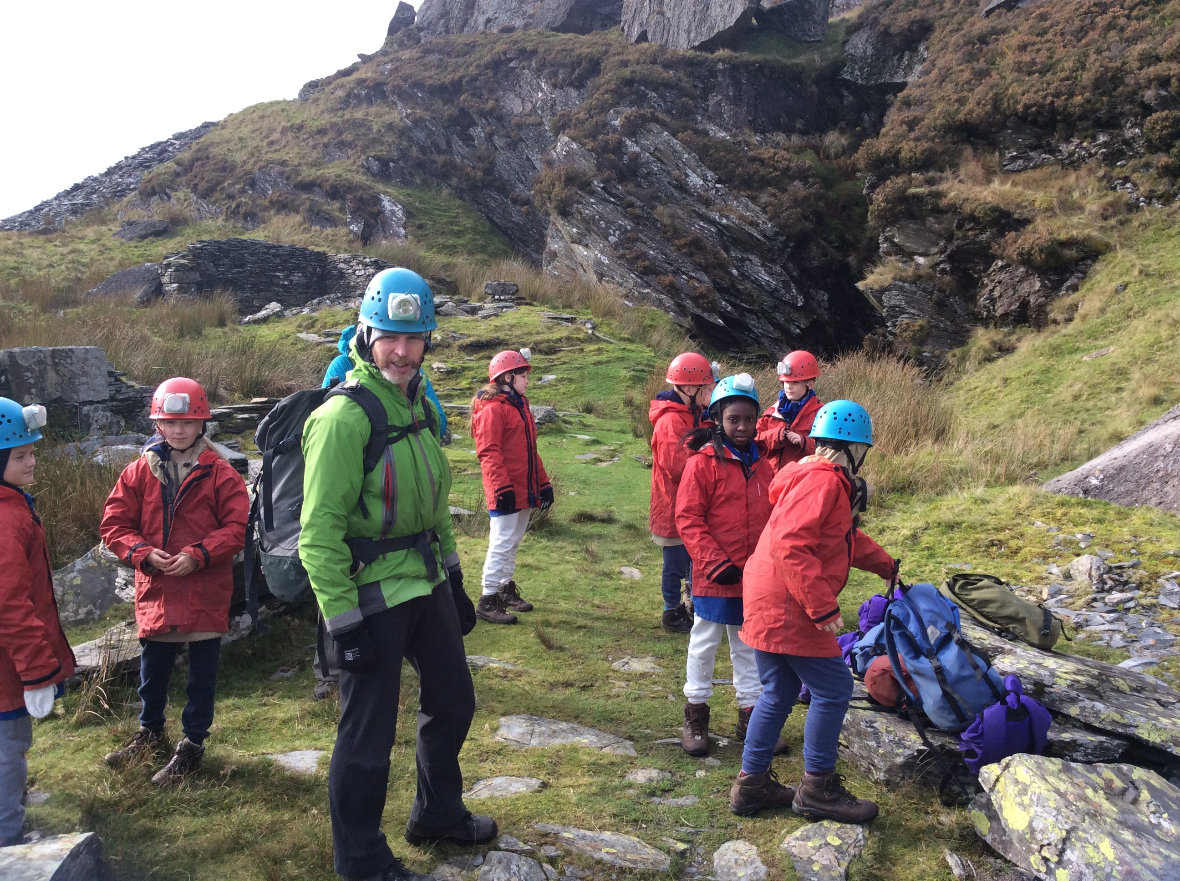
Going underground - Mine

Slide 10
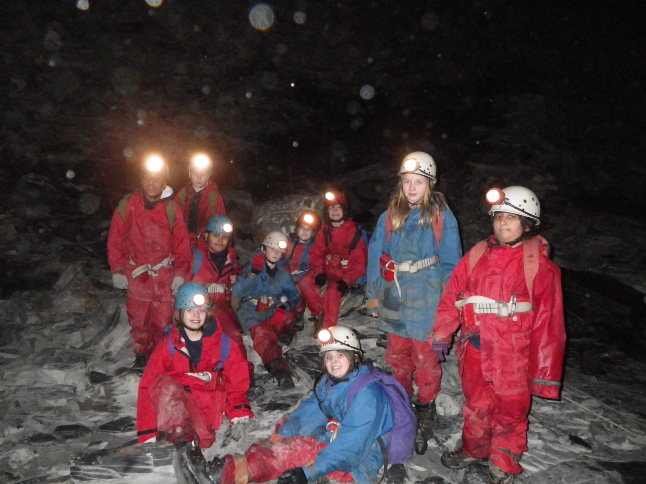
Enjoying the darkness and peace together

Slide 11
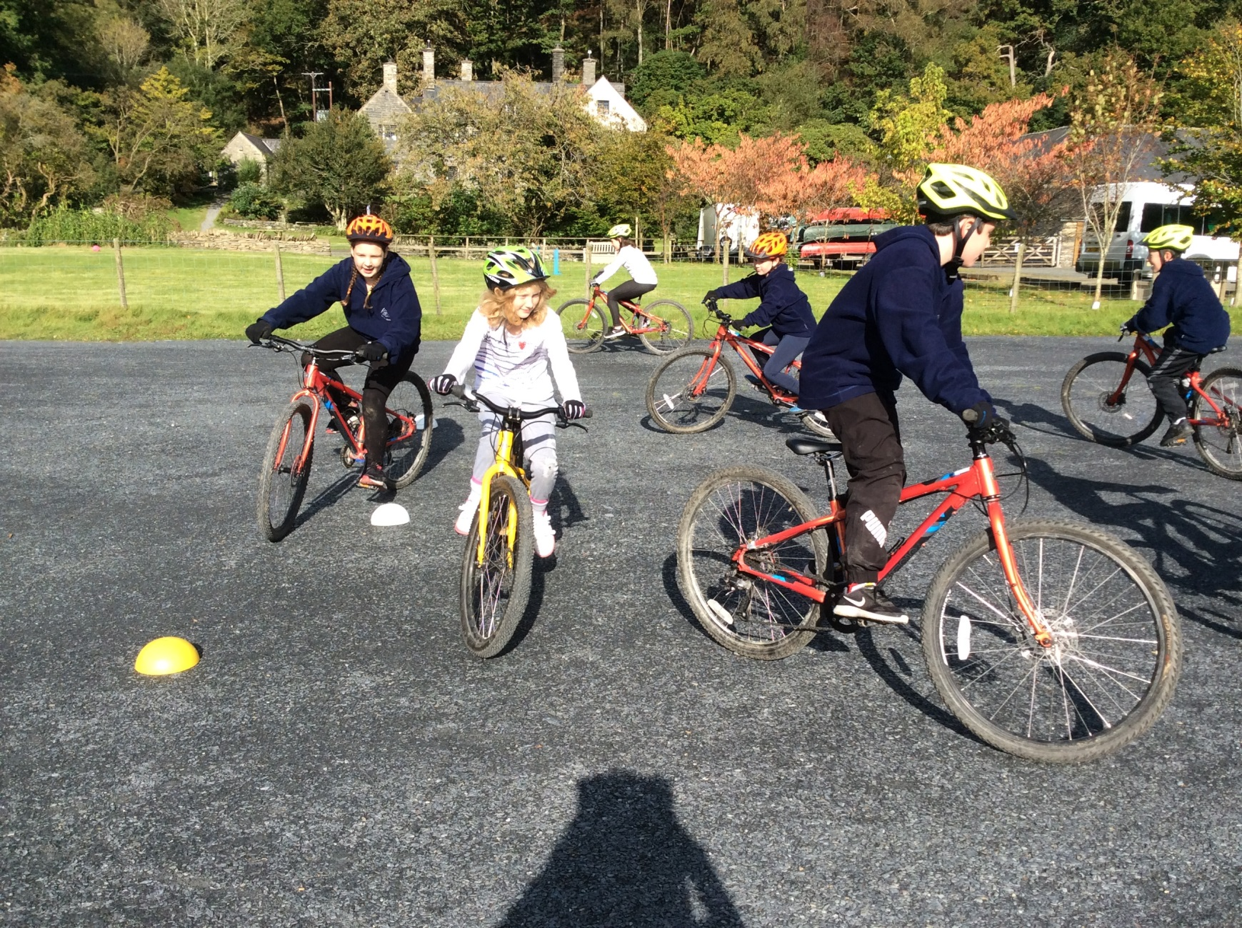
Level ground biking

Slide 12
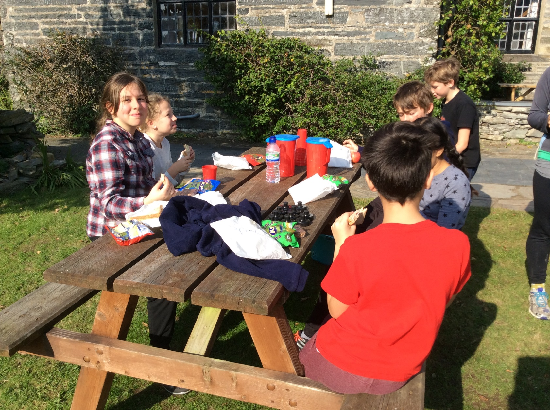
Personal and social development – spending time with friends

Slide 13
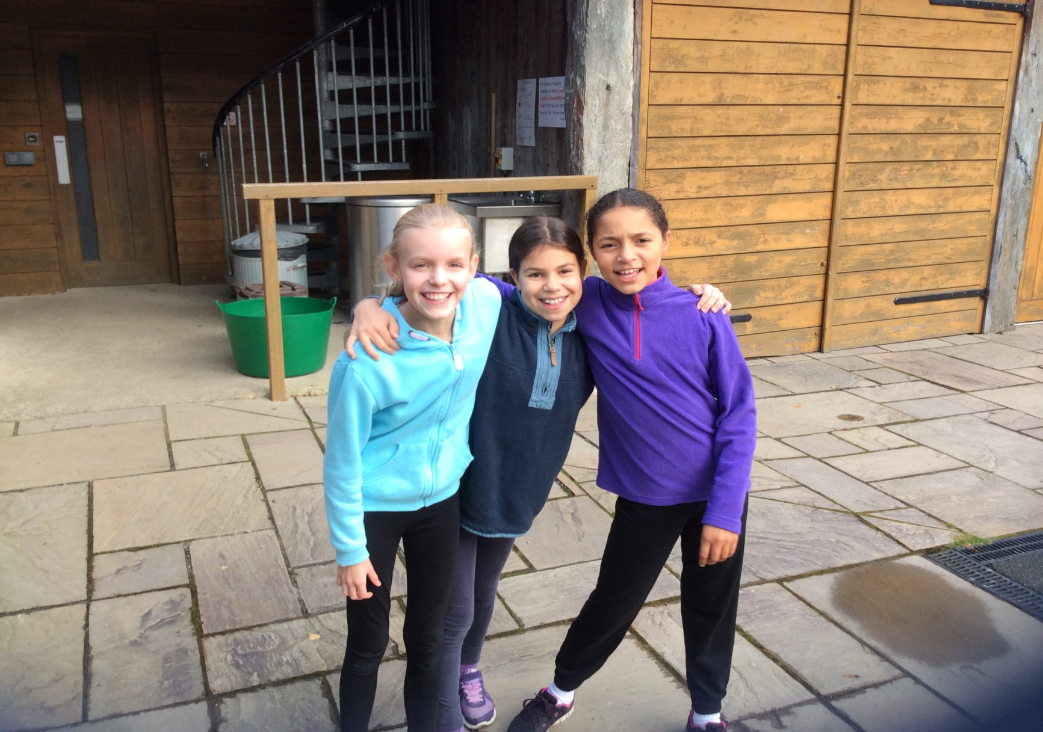
Making life-long memories with friends

Slide 14
Risk Assessment, Medical and Consent
Risk Assessments and Insurance will be completed by school before we go
Medical and consent details are required from you as parents - all staff (including the Dol y Moch staff) will be informed of medical needs of children, all forms are taken with us and copies given to the centre
All dietary requirements are recorded and sent off to Dol y Moch, the kitchen staff then design the meals to cater for everyone and their needs

Slide 15
Medicines, Inhalers, Travel sickness tablets
All medication should be named with instructions for administering, this should be given to a member of school staff on the day that we leave.
This includes travel sickness tablets. If your child has ever suffered from travel sickness in the past then please make sure they have taken some precaution. Send tablets for the return journey with your child and give them in on the day that we leave.
All inhalers/Epi-pens should be full and labelled. We would also like to take any spares you have too.

Slide 16
Equipment
Refer to the kit list – Year 6 class page
Make sure everything is named
Waterproofs are provided by the centre
Walking boots provided by the centre
Wellingtons are provided by the centre
Pack old clothes – the children will get dirty!
Bedding is provided but the children need to know how to use it!!!!!

Slide 17
Travel
We will leave E.P.S early on the afternoon of Tuesday 24th September
We will arrive early evening at P.D.Y.M.
We will text you when we get to Plas Dol y Moch to let you know we have arrived safely.
This same process will happen on the way back, Sat 28th September, informing you of our arrival time back at school (approx 1pm).

Slide 18
On arrival
The children will know their activity groups before we leave.
5-6 Activity groups – approx 10 in each
Single gender rooms of various sizes
Your child will be told their sleeping arrangements when they arrive at Plas Dol y Moch

Slide 19
Rules
School rules apply for the entire week, and are applied alongside the centre’s rules
When travelling, seat belts are worn at all times
The children will not be allowed to leave the grounds of the site unless accompanied by an adult.
No mobile phones are allowed

Slide 20
Pocket money
£10 (£1 a day for evening tuck shop, plus money for the giftshop at end of visit).
Children must give their money to staff on the Friday morning in a named purse/wallet.
Earlsdon staff will keep the wallets/purses safe and allow the children access to their money when they need it.

Slide 21
Extras
Children can bring cameras (disposable are ideal)
Having a watch is advisable
Children can bring electrical items (ipads/Switch etc) for the journey there and back but the children are responsible for them (please name them) – these will be collected in as soon as we arrive at Plas Dol y Moch as they are designed to entertain the children for the journeys only.

Slide 22
Things to practise…
Putting a sheet on a bed, a cover on a quilt and a pillowcase on a pillow
Making a sandwich
Packing luggage
Please ensure the children know what items they have brought with them so that packing for the return journey is easier

Slide 23
On the year 6 class page of the school website you will find:
A kit list of things your child needs
An example of a typical day at Plas Dol y Moch
Year 6 class page – use the link to access
We will be giving your children updates on useful information over the next few weeks they need to pass this on to you

Slide 24
So finally…
All luggage should be clearly labelled.
Casual clothes (including a coat) to be worn for travel there and back.
We will leave for Plas Dol y Moch early afternoon on Tues 24th September.
Return from P.D.Y.M on Sat 28th Sept, leaving at approx 9.00 – estimated time of arrival back at school 1pm
We will message you when we are approximately 30 mins away
Wait outside school to pick up children when they return

Slide 25
Any queries or questions
If you have a question or something that you need clarifying then please contact Miss Haines / Mr Gascoyne via email to the school office
If your child has any questions then they can ask a member of the Y6 teaching staff or Mr Gascoyne

