Slide 1




THE ECO TEAM
What do we do? & Why are we here?

Slide 2






WE ARE:
BRIONY
AND SOPHIE
ELIZABETH (BETH)
EVIE
FAYE
KITTY

Slide 3
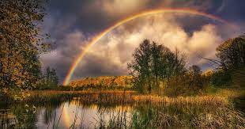
Why are we here?
We are here to keep tabs on the school's environment and help improve it.
This powerpoint will show you how you can get involved, how you can help us ,and what we have been doing
We hope you enjoy this presentation

Slide 4

What have we done so far this year?
We have formed the schools ECO Team – and that is US!
We have been meeting regularly to discuss what we want to achieve and how we can do this.
We have completed a survey that you will see by our Headteachers office along with the letters ECO (eco) that we made out of your (and our) litter, this will show you what we are good at and what we need to improve.
We have managed to raise £500 and will be hoping to use this money to design a sensory garden by Year 1 area
We have managed to impress some of our parents and have donations of bird houses, bat boxes and much more – we have written and sent out thank you cards

Slide 5

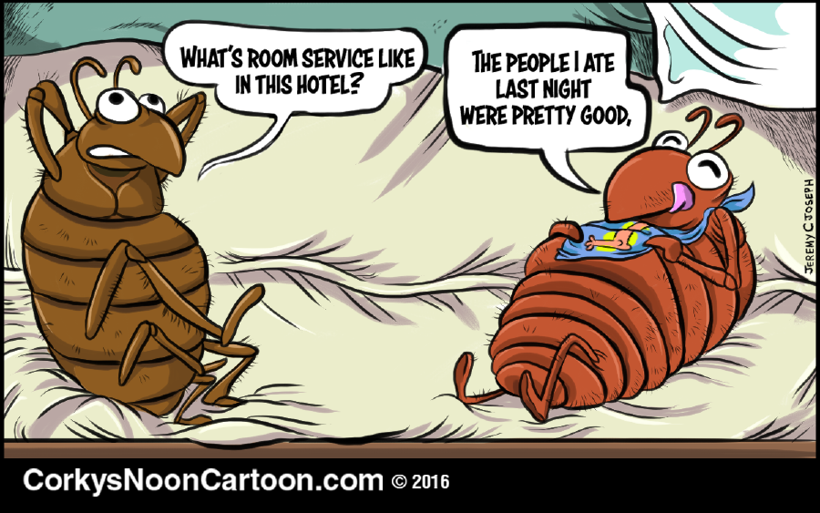


What do we hope to achieve in future?
COMPOST BINS
BIRD/BUG HOUSES/HOTELS AND DEVELOP A SENSORY GARDEN
DO A SPONSORED LITTER PICK
DESIGN A BIRD HOUSE COMPETITION
MAKE AN EARLSDON PRIMARY SCHOOL ECO POEM
PLANT MORE PLANTS

Slide 6
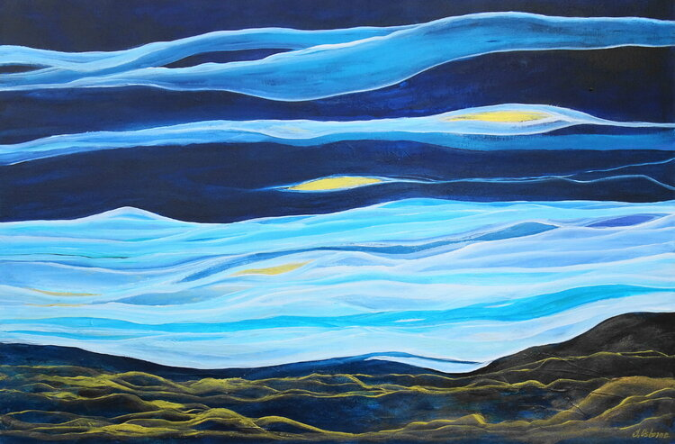

What else
We hope to have more PEOPLE join our team at some point in the year too!

Slide 7

Design a bird house competition
We would love for you to design a bird house! The winning design will have abird box painted in that style.
It is 20p to enter and all proceeds will go towards our
ECO award and our schools environment.
Make sure your name is on your entry!

Slide 8

FUN FACT
Did you know.....
That a sunflower is actually made up of millions of other microscopic flowers!!!!
Well now you do

Slide 9

If you have any suggestions or questions...
please come to us
we will be happy to hear
your opinions
!!!!!!!

Slide 10

Thank you for watching
Continue being the best thing the best thing since sliced bread
And have a good life
Love your environment!!

